Slide 1

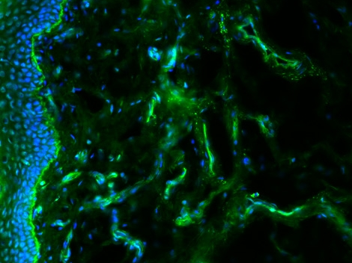
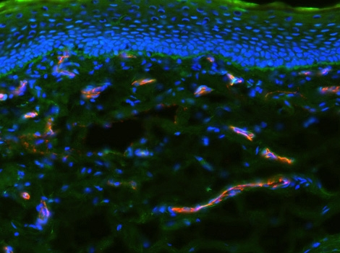
ReliaTech GmbH
Rabbit anti-human Endomucin
(Cat #102-PA49)
K22973
K22974
Immunofluorescence staining (green) of cryo-sections of human foreskin (fixed 15 min in 4% PFA) with anti-human Endomucin (5µg/ml) [Cat# 102-PA49] and counter staining of nuclei with Dapi (left panel) and double staining wit anti-CD31 (right panel).
The experiment was performed by the research group of Prof. Dr. J. Wilting and Dr. K. Buttler, University Göttingen, Germany.
http://www.reliatech.de / orders@reliatech.de

